Slide 1
Machine Learning Implementations in Arabic Text Classification
Marwa F. Mohamed

Slide 2
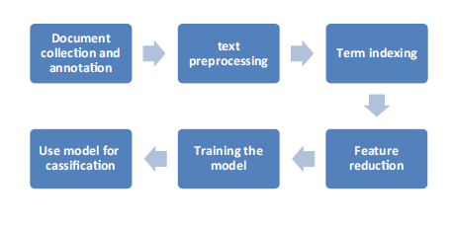
Text Classification Steps

Slide 3
Feature reduction
Feature reduction, also known as dimensionality reduction.
Is the process of reducing the number of features in a resource heavy computation without losing important information.
Reducing the number of features means the number of variables is reduced making the computer’s work easier and faster.

Slide 4
Feature Selection Methods.
The aim of feature-selection methods is the
reduction of the dimensionality of the dataset by removing features that are considered irrelevant for the classification.
The most popular feature selection methods used for text classification are
Information Gain.
Mutual Information.
Odds Ratio.

Slide 5
Training the Model

Slide 6
Training Data
The final step in corpus preparation is to split the corpus into training and test data.
The training data contain the larger portion of the corpus and is used for training the classifier.
The testing set is used then to test the performance of the classifier.
The test does not guarantee good classification performance due to the overfitting problem.

Slide 7
Underfitting and Overfitting
There are two kinds of mistakes that an inappropriate inductive bias can lead to: underfitting and overfitting.
Underfitting occurs when the prediction model selected by the algorithm is too simplistic to represent the underlying relationship in the dataset between the descriptive features and the target feature.
Overfitting, by contrast, occurs when the prediction model selected by the algorithm is so complex that the model fits to the dataset too closely and becomes sensitive to noise in the data.

Slide 8
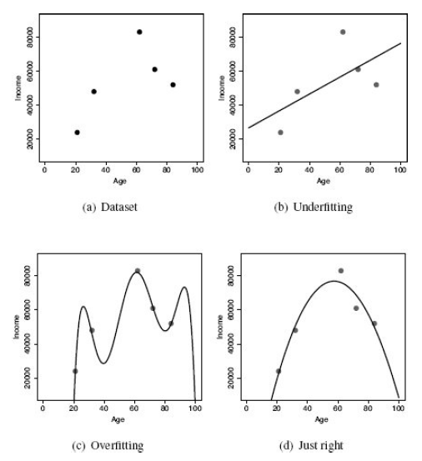

Slide 9
Example
It could be exemplified by a student preparing for an exam by memorizing the answers to the book exercises rather than understanding the solution approach.
A student doing so will do well in the final exam if only the exam included textbook questions.
But if he finds other questions he will do poorly, simply because he was not able to generalize the concept and probably will fail.

Slide 10
Cross-validation
Process which aims at ensuring that the learned model doesn’t overfit.
Crossvalidation is done by splitting the data into a number of near-size folds k and running k experiments.
In each experiment, we set aside one of the k folds for testing and use all the remaining folds for training.

Slide 11
Cross-validation
A high variance
in the results of the experiments refer to overfitting.
The solution of extending the data size or choosing other less complex training models.
A low variance indicates positively to the problem.

Slide 12

Cross-validation

Slide 13
Classification Model

Slide 14
Classification
Is a generic process that assigns a label to an input based on the input characteristics.
A classifier can be as
Simple as classifying a number as being positive or negative, and
Complicated as a physician diagnosing his patient by inspecting his MRI images and ECG signals.

Slide 15
Classification Algorithms
The number of classification algorithms that have been used for topic categorization is overwhelming.
These include at the very least
probabilistic methods,
regression methods,
decision tree,
neural networks,
batch and incremental learners of linear classifiers,
support vector machines,
genetic algorithms,
hidden Markov models,
ensemble and boosting methods.

Slide 16
Classification Algorithm
Decision Tree
Feature Selection Method
Information Gain

Slide 17
Decision Tree

Slide 18
Decision Tree
It builds classification or regression models in the form of a tree structure.
It breaks down a dataset into smaller and smaller subsets while at the same time an associated decision tree is incrementally developed.

Slide 19
Decision Tree
The final result is a tree with decision nodes and leaf nodes.
The core algorithm for building decision trees called ID3 which employs a top-down, greedy search through the space of possible branches with no backtracking.

Slide 20
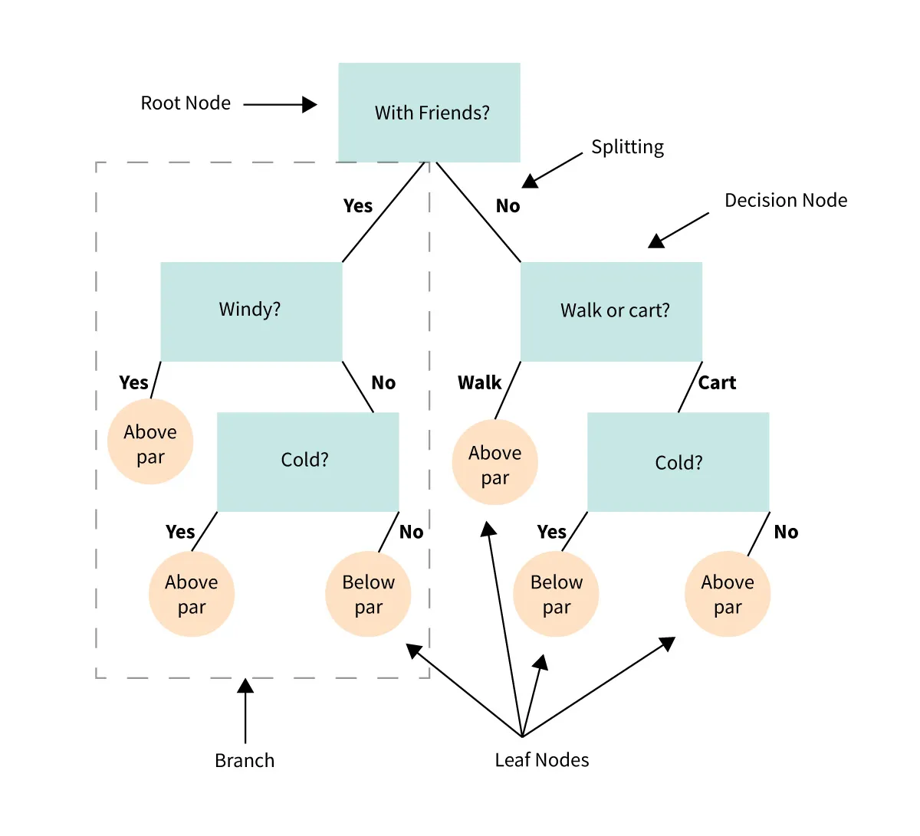

Slide 21
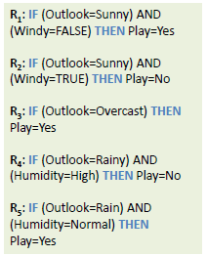
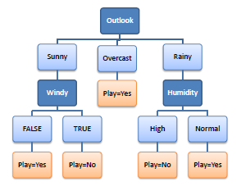
Decision Tree to Decision Rules
Notes:
A decision tree can easily be transformed to a set of rules by mapping from the root node to the leaf nodes one by one.

Slide 22
Example
A decision node (e.g., Outlook) has two or more branches (e.g., Sunny, Overcast and Rainy).
Leaf node (e.g., Play) represents a classification or decision.
The topmost decision node in a tree which corresponds to the best predictor called root node.
Decision trees can handle both categorical and numerical data.

Slide 23
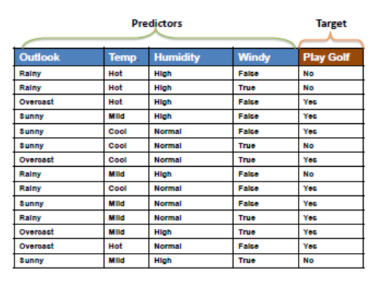
Example

Slide 24
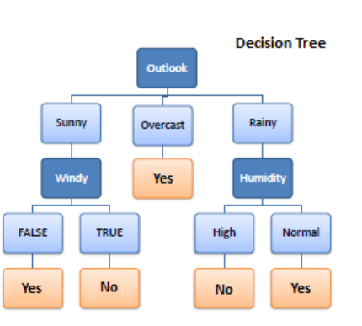
Example

Slide 25
Entropy
A decision tree is built top-down from a root node and involves partitioning the data into subsets that contain instances with similar values (homogenous).
ID3 algorithm uses entropy to calculate the homogeneity of a sample.
If the sample is completely homogeneous the entropy is zero.
If the sample is an equally divided it has entropy of one.

Slide 26
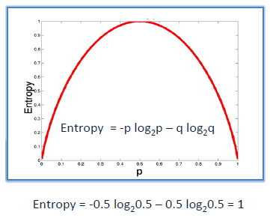
Entropy

Slide 27
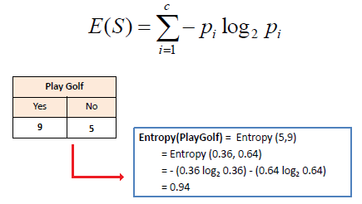
Example: Entropy using the frequency table of one attribute

Slide 28
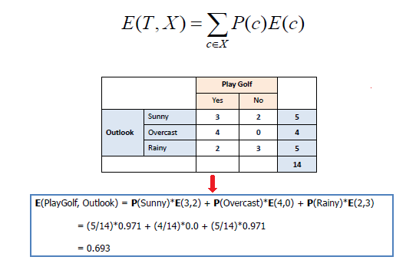
Example Entropy using the frequency table of two attributes:
Notes:
E(3,2) = E(3/5,2/5) = E(0.6,0.4) = -(0.6 log₂ 0.6) – (0.4 log₂ 0.4) = .97
E(4,0) = E(1,0) = -(1 log₂ 1) – (0 log₂ 0) = 0
E( 2,3 ) = – (0.4 log₂ 0.4) -(0.6 log₂ 0.6) = .97

Slide 29
E(3,2) = E(3/5,2/5) = E(0.6,0.4) = -(0.6 log₂ 0.6) – (0.4 log₂ 0.4) = 0.97
E(4,0) = E(1,0) = -(1 log₂ 1) – (0 log₂ 0) = 0
E( 2,3 ) = – (0.4 log₂ 0.4) -(0.6 log₂ 0.6) = 0.97

Slide 30
Information Gain
The information gain is based on the decrease in entropy after a dataset is split on an attribute.
Constructing a decision tree is all about finding attribute that returns the highest information gain (i.e., the most homogeneous branches).

Slide 31
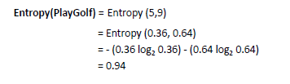
Step 1: Calculate entropy of the target

Slide 32
Step 2:
The dataset is then split on the different attributes.
The entropy for each branch is calculated.
Then it is added proportionally, to get total entropy for the split.
The resulting entropy is subtracted from the entropy before the split.
The result is the Information Gain, or decrease in entropy.

Slide 33
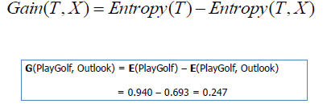
Step 2:

Slide 34
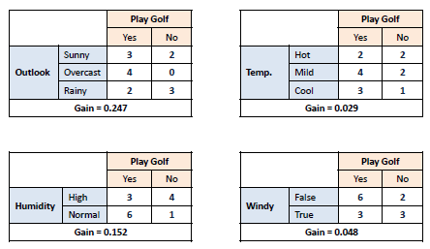
Step 2:

Slide 35
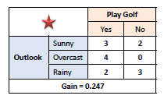
Step 3:
Choose attribute with the largest information gain as the decision node
Divide the dataset by its branches and repeat the same process on every branch.

Slide 36
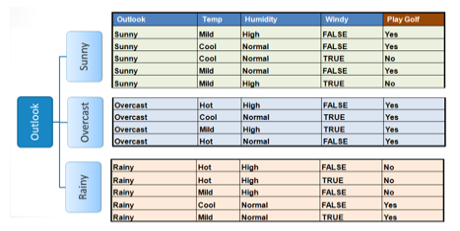
Step 3:

Slide 37
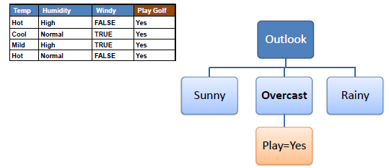
Step 4a: A branch with entropy of 0 is a leaf node.

Slide 38
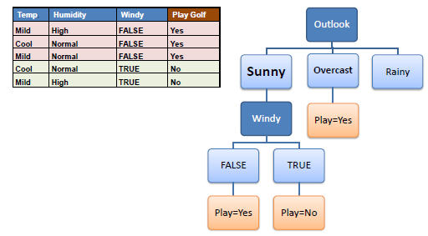
Step 4b: A branch with entropy more than 0 needs further splitting.

Slide 39
Step 5:
The ID3 algorithm is run recursively on the non-leaf branches, until all data is classified.

Slide 40
Decision Tree to Decision Rules
Notes:
A decision tree can easily be transformed to a set of rules by mapping from the root node to the leaf nodes one by one.

Slide 41
DT Python Example

Slide 42
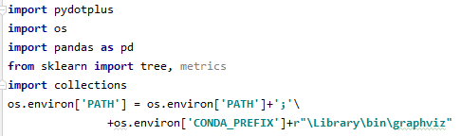
Step 1: Import necessary libraries

Slide 43
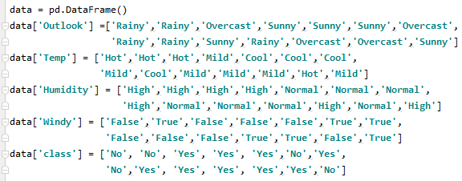
Step 2: Create the data set

Slide 44
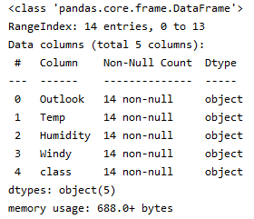
Step 3: Check a few information about the data set

Slide 45


Step 4: Identify the target variable

Slide 46
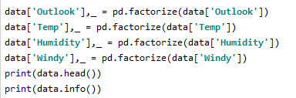
Step 5: Identify the predictor variables and encode any string variables to equivalent integer codes

Slide 47
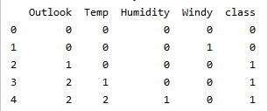
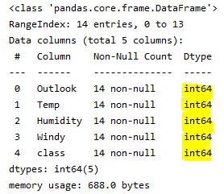
Step 5: (output)

Slide 48

Step 6: Training/model fitting

Slide 49
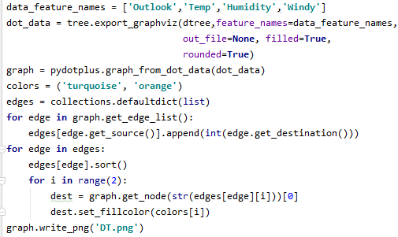
Step 7: Visualization of the decision graph

Slide 50
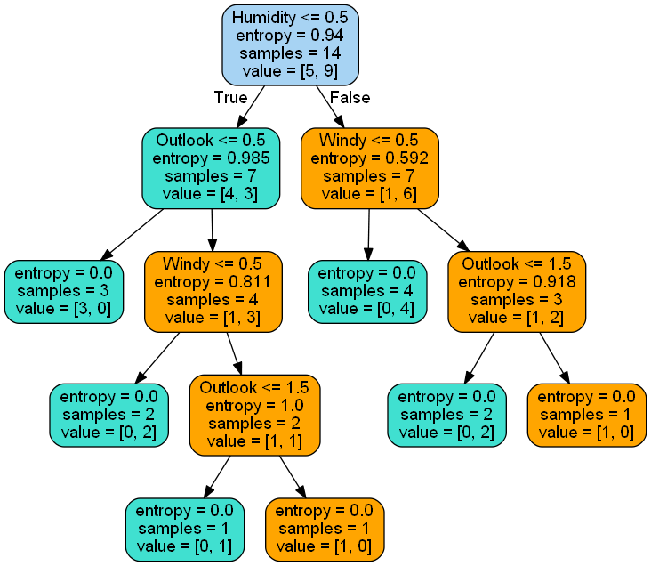
Step 7: (output)

Slide 51

Step 8: use the model to make predictions with the test data
output

Slide 52
References
Elarnaoty, M. and Farghaly, A., 2018. Machine learning implementations in arabic text classification. In Intelligent Natural Language Processing: Trends and Applications (pp. 295-324). Springer, Cham.
http://www.saedsayad.com/decision_tree.htm
https://acadgild.com/blog/decision-tree-python-code

Slide 53
Task

Slide 54
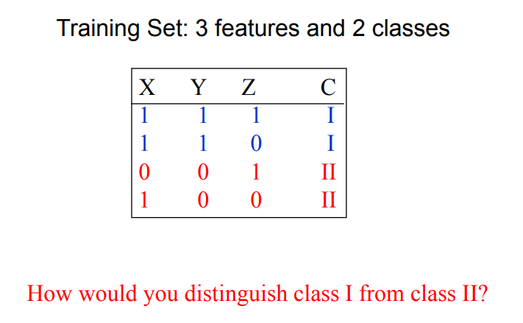
Task

Slide 55
Question 1: Decision trees are also known as CART. What is CART? (A) Classification and Regression Trees (B) Customer Analysis and Research Tool (C) Communication Access Real-time Translation (D) Computerized Automatic Rating Technique

Slide 56
Question 1: Decision trees are also known as CART. What is CART? (A) Classification and Regression Trees (B) Customer Analysis and Research Tool (C) Communication Access Real-time Translation (D) Computerized Automatic Rating Technique

Slide 57
Question 2: What are the advantages of Classification and Regression Trees (CART)? (A) Decision trees implicitly perform variable screening or feature selection (B) Can handle both numerical and categorical data (C) Can handle multi-output problems. (D) All of the above

Slide 58
Question 2: What are the advantages of Classification and Regression Trees (CART)? (A) Decision trees implicitly perform variable screening or feature selection (B) Can handle both numerical and categorical data (C) Can handle multi-output problems. (D) All of the above

Slide 59
Question 5: Decision tree learners may create biased trees if some classes dominate. What’s the solution of it? (A) balance the dataset prior to fitting (B) imbalance the dataset prior to fitting (C) balance the dataset after fitting (D) No solution possible

Slide 60
Question 5: Decision tree learners may create biased trees if some classes dominate. What’s the solution of it? (A) balance the dataset prior to fitting (B) imbalance the dataset prior to fitting (C) balance the dataset after fitting (D) No solution possible

Slide 61
Question 6: Decision tree can be used for ______. (A) classification (B) regression (C) Both (D) None of these

Slide 62
Question 6: Decision tree can be used for ______. (A) classification (B) regression (C) Both (D) None of these

Slide 63
Question 7: Decision tree is a ______ algorithm. (A) supervised learning (B) unsupervised learning (C) Both (D) None of these

Slide 64
Question 7: Decision tree is a ______ algorithm. (A) supervised learning (B) unsupervised learning (C) Both (D) None of these

Slide 65
Question 8: Suppose, your target variable is whether a passenger will survived or not using Decision Tree. What type of tree do you need to predict the target variable? (A) classification tree (B) regression tree (C) clustering tree (D) dimensionality reduction tree

Slide 66
Question 8: Suppose, your target variable is whether a passenger will survived or not using Decision Tree. What type of tree do you need to predict the target variable? (A) classification tree (B) regression tree (C) clustering tree (D) dimensionality reduction tree

Slide 67
Question 9: Suppose, your target variable is the price of a house using Decision Tree. What type of tree do you need to predict the target variable? (A) classification tree (B) regression tree (C) clustering tree (D) dimensionality reduction tree

Slide 68
Question 9: Suppose, your target variable is the price of a house using Decision Tree. What type of tree do you need to predict the target variable? (A) classification tree (B) regression tree (C) clustering tree (D) dimensionality reduction tree

Slide 69
Question 10: What is the maximum depth in a decision tree? (A) the length of the longest path from a root to a leaf (B) the length of the shortest path from a root to a leaf (C) the length of the longest path from a root to a sub-node (D) None of these

Slide 70
Question 10: What is the maximum depth in a decision tree? (A) the length of the longest path from a root to a leaf (B) the length of the shortest path from a root to a leaf (C) the length of the longest path from a root to a sub-node (D) None of these

Slide 71
Question 1: What is splitting in the decision tree? (A) Dividing a node into two or more sub-nodes based on if-else conditions (B) Removing a sub-node from the tree (C) Balance the dataset prior to fitting (D) All of the above

Slide 72
Question 1: What is splitting in the decision tree? (A) Dividing a node into two or more sub-nodes based on if-else conditions (B) Removing a sub-node from the tree (C) Balance the dataset prior to fitting (D) All of the above

Slide 73
Question 2: What is a leaf or terminal node in the decision tree?
(A) The end of the decision tree where it cannot be split into further sub-nodes. (B) Maximum depth (C) A subsection of the entire tree (D) A node that represents the entire population or sample

Slide 74
Question 2: What is a leaf or terminal node in the decision tree?
(A) The end of the decision tree where it cannot be split into further sub-nodes. (B) Maximum depth (C) A subsection of the entire tree (D) A node that represents the entire population or sample

Slide 75
Question 3: What is pruning in a decision tree? (A) Removing a sub-node from the tree (B) Dividing a node into two or more sub-nodes based on if-else conditions (C) Balance the dataset prior to fitting (D) All of the above

Slide 76
Question 3: What is pruning in a decision tree? (A) Removing a sub-node from the tree (B) Dividing a node into two or more sub-nodes based on if-else conditions (C) Balance the dataset prior to fitting (D) All of the above

Slide 77
Question 6: In a decision tree algorithm, entropy helps to determine a feature or attribute that gives maximum information about a class which is called _____. (A) Pruning (B) Information gain (C) Maximum depth (D) Gini impurity

Slide 78
Question 6: In a decision tree algorithm, entropy helps to determine a feature or attribute that gives maximum information about a class which is called _____. (A) Pruning (B) Information gain (C) Maximum depth (D) Gini impurity

Slide 79
Question 7: In a decision tree algorithm, how can you reduce the level of entropy from the root node to the leaf node? (A) Pruning (B) Information gain (C) Maximum depth (D) Gini impurity

Slide 80
Question 7: In a decision tree algorithm, how can you reduce the level of entropy from the root node to the leaf node? (A) Pruning (B) Information gain (C) Maximum depth (D) Gini impurity

Slide 81
Question 8: What are the advantages of the decision tree? (A) Decision trees are easy to visualize (B) Non-linear patterns in the data can be captured easily (C) Both (D) None of the above

Slide 82
Question 8: What are the advantages of the decision tree? (A) Decision trees are easy to visualize (B) Non-linear patterns in the data can be captured easily (C) Both (D) None of the above

Slide 83
Question 9: What are the disadvantages of the decision tree? (A) Over-fitting of the data is possible. (B) The small variation in the input data can result in a different decision tree (C) We have to balance the dataset before training the model (D) All of the above

Slide 84
Question 9: What are the disadvantages of the decision tree? (A) Over-fitting of the data is possible. (B) The small variation in the input data can result in a different decision tree (C) We have to balance the dataset before training the model (D) All of the above

Slide 85
Question 10: In Decision Trees, for predicting a class label, the algorithm starts from which node of the tree? (A) Root (B) Leaf (C) Terminal (D) Sub-node
Notes:
The solution of Machine Learning Quiz 06: 1(A), 2(A), 3(A), 4(D), 5(C), 6(B), 7(B), 8(C), 9(D), 10(A)

Slide 86
Question 10: In Decision Trees, for predicting a class label, the algorithm starts from which node of the tree? (A) Root (B) Leaf (C) Terminal (D) Sub-node
Notes:
The solution of Machine Learning Quiz 06: 1(A), 2(A), 3(A), 4(D), 5(C), 6(B), 7(B), 8(C), 9(D), 10(A)

Slide 87
Question 1: In a decision tree, which one is true for the root node? (A) The root node represents the entire population or sample (B) Nodes do not split is called the root node (C) Root and leaf node are the same (D) All of the above

Slide 88
Question 2: What is Decision Node in a decision tree? (A) The end of the decision tree where it cannot be split into further sub-nodes. (B) When a sub-node splits into further sub-nodes, then it is called the decision node (C) The entire population or sample (D) All of the above

Slide 89
Question 3: What is Branch in a decision tree? (A) A subsection of the entire tree (B) When a sub-node splits into further sub-nodes, then it is called the decision node (C) The entire population or sample (D) All of the above

Slide 90
Question 4: In the decision tree algorithm, a node that is divided into sub-nodes is called a _____ node of sub-nodes whereas sub-nodes are the _____ of a parent node. (A) child, parent (B) root, leaf (C) leaf, root (D) parent, child

Slide 91
Question 5: For a decision tree, which options are true? (Select two) (A) Root node represents the entire population or sample (B) When a sub-node splits into further sub-nodes, then it is called the decision node (C) When a sub-node splits into further sub-nodes, then it is called the root node (D) leaf node and terminal node are different

Slide 92
Question 6: For a decision tree, which options are true? (Select two) (A) Nodes that do not split is called Leaf or Terminal node (B) Nodes that do not split is called the root node (C) A node, which is divided into sub-nodes is called a parent node of sub-nodes whereas sub-nodes are the child of a parent node (D) A node that is divided into sub-nodes is called a child node of sub-nodes whereas sub-nodes are the leaf of a parent node

Slide 93
Question 7: For a decision tree, which options are true? (Select two) (A) Splitting and pruning are the same (B) When we remove sub-nodes of a decision node, this process is called splitting (C) Splitting is a process of dividing a node into two or more sub-nodes (D) When we remove sub-nodes of a decision node, this process is called pruning

Slide 94
Question 8: A decision tree classifier selects the attribute which has the _____ Entropy or Largest Information gain. (A) smallest (B) largest (C) mean (D) median

Slide 95
Question 10: A decision tree classifier selects the attribute which has the smallest Entropy or _____ Information gain. (A) smallest (B) largest (C) mean (D) median

Slide 96
A _________ is a decision support tool that uses a tree-like graph or model of decisions and their possible consequences, including chance event outcomes, resource costs, and utility. a) Decision tree b) Graphs c) Trees d) Neural Networks
Notes:
View Answer
Answer: a Explanation: Refer the definition of Decision tree

Slide 97
Decision Nodes are represented by ____________ a) Disks b) Squares c) Circles d) Triangles
Notes:
View Answer
Answer: b Explanation: None.

